Slide 1
LAZY FUNCTIONAL PROGRAMMING
By: Adriana Coronel

Slide 2
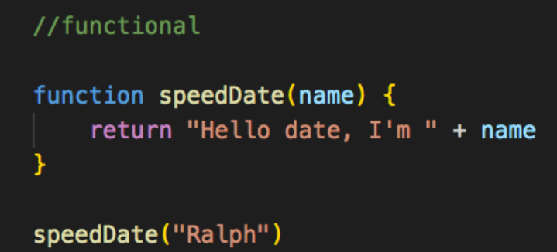
Functional Programming
What is functional programming?
Any higher order languages that uses recursive
functions for code organization.
The programming language handles the functions like a tree made from expressions that map values
Notes:
*1 which create the best effect for fast and clean software
*2 which is based on mathematical functions instead of getting a sequence of statements which update as the program is in execution.

Slide 3
Types of Functional Programming Languages
Lisp
Python
Erlang
Haskell
Clojure
Notes:
Some of the popular functional programming languages.
Both lisp and python are considered to work with both object oriented programming and functional programming

Slide 4
Lazy Functional Programming
Lazy Evaluation in Functional Programming
“Lazy” in programming means to avoid a task until it
becomes necessary.
* Important in functional programming:
Allows the programmer to access elements of data structures out of order.
Notes:
Also known as lazy evaluation
*1 therefore we evaluate an expression or set of values at the time it is first used/encountered
*2 since it only stores the values when needed

Slide 5
Advantages Disadvantages
Reduces time complexity of an algorithm
Best when loading data which can be rarely accessed in the data structure
Allows the language runtime to dump sub-expressions that are not in use
Forces the language to hold a sub-expression until is required
Sometimes increases space complexity of an algorithm
Notes:
By dumping the temporary computations
DA
By creating delayed objects

Slide 6
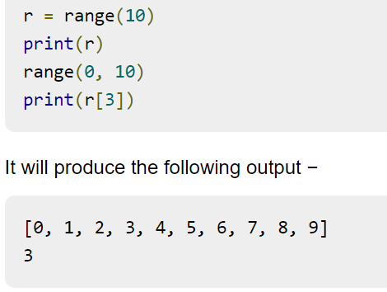
Example
Using Python:
The range method follows lazy evaluation
Notes:
Here I have an examples that i found online on lazy evaluations
*1 by saving the execution time for bigger ranges and not including all the values the same time to save memory consumption

Slide 7
Resources
https://www.learningjournal.guru/article/scala/functional-programming/non-strict-lazy-evaluations-in-functional-programming/
https://www.tutorialspoint.com/functional_programming/functional_programming_introduction.htm#:~:text=Some%20of%20the%20popular%20functional,%2C%20Haskell%2C%20Clojure%2C%20etc.
https://javascript.plainenglish.io/functional-v-object-oriented-programming-part-i-what-is-functional-programming-217c66ca8801

